Slide 1
Malignant Comment Classifier
Submitted by
Mr.A.J.Wakchaure
Intern Data Science

Slide 2
Problem Statement
The proliferation of social media enables people to express their opinions widely online. However, at the same time, this has resulted in the emergence of conflict and hate, making online environments uninviting for users. Although researchers have found that hate is a problem across multiple platforms, there is a lack of models for online hate detection.
Online hate, described as abusive language, aggression, cyberbullying, hatefulness and many others has been identified as a major threat on online social media platforms. Social media platforms are the most prominent grounds for such toxic behaviour.
There has been a remarkable increase in the cases of cyberbullying and trolls on various social media platforms. Many celebrities and influences are facing backlashes from people and have to come across hateful and offensive comments. This can take a toll on anyone and affect them mentally leading to depression, mental illness, self-hatred and suicidal thoughts

Slide 3
Conceptual Background
Internet comments are bastions of hatred and vitriol. While online anonymity has provided a new outlet for aggression and hate speech, machine learning can be used to fight it.
The problem we sought to solve was the tagging of internet comments that are aggressive towards other users. This means that insults to third parties such as celebrities will be tagged as unoffensive, but “u are an idiot” is clearly offensive.
Our goal is to build a prototype of online hate and abuse comment classifier which can used to classify hate and offensive comments so that it can be controlled and restricted from spreading hatred and cyber bullying

Slide 4
Mathematical/ Analytical Modeling of the Problem
This was a NLP Project and in this project we deals with the textual data and for understanding the data we used some methods like removing punctuations ,numbers, stopwords and using the lemmatization process convert the complex words into their simpler forms.
These processes helped in cleaning the unwanted words form the comments and we were left with only those words which were going to help in our model building.
After cleaning the data we used TF-IDF Vectorizer technique to convert textual data into vector form.
This technique works on the basis of the frequency of words present in the document. After training with train dataset we use this technique into test dataset.

Slide 5
Data Sources
This data was provided to me by FlipRobo Technologies into a csv file format. This file contains training and testing dataset. On training dataset we build a model and using this model we have to predict the outcomes from testing dataset.
The data set contains the training set, which has approximately 1,59,000 samples and the test set which contains nearly 1,53,000 samples. All the data samples contain 8 fields which includes ‘Id’, ‘Comments’, ‘Malignant’, ‘Highly malignant’, ‘Rude’, ‘Threat’, ‘Abuse’ and ‘Loathe’.
The label can be either 0 or 1, where 0 denotes a NO while 1 denotes a YES. There are various comments which have multiple labels. The first attribute is a unique ID associated with each comment.

Slide 6
Data Sources
-Malignant: It is the Label column, which includes values 0 and 1, denoting if the comment is malignant or not.
-Highly Malignant: It denotes comments that are highly malignant and hurtful.
-Rude: It denotes comments that are very rude and offensive.
-Threat: It contains indication of the comments that are giving any threat to someone.
-Abuse: It is for comments that are abusive in nature.
-Loathe: It describes the comments which are hateful and loathing in nature.

Slide 7
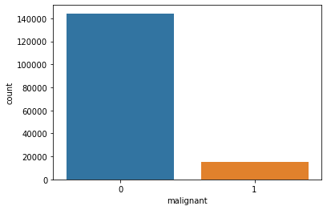
Univariate Analysis Malignant

Slide 8
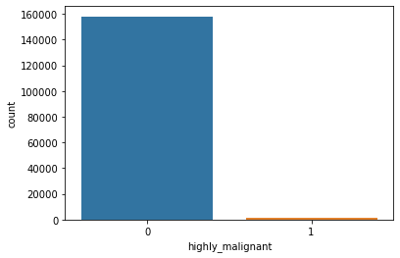
Highly Malignant

Slide 9
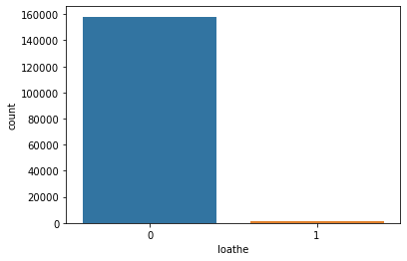
Loathe

Slide 10
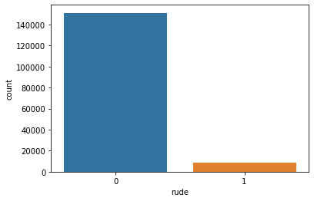
Rude

Slide 11
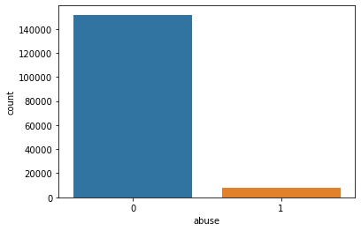
Abuse

Slide 12

Threat

Slide 13
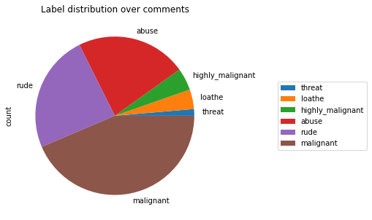
Label

Slide 14
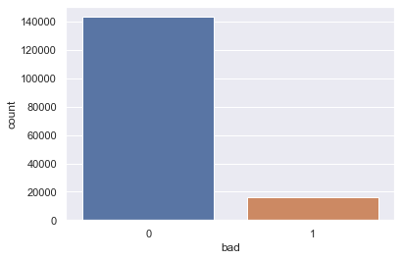
Bad

Slide 15
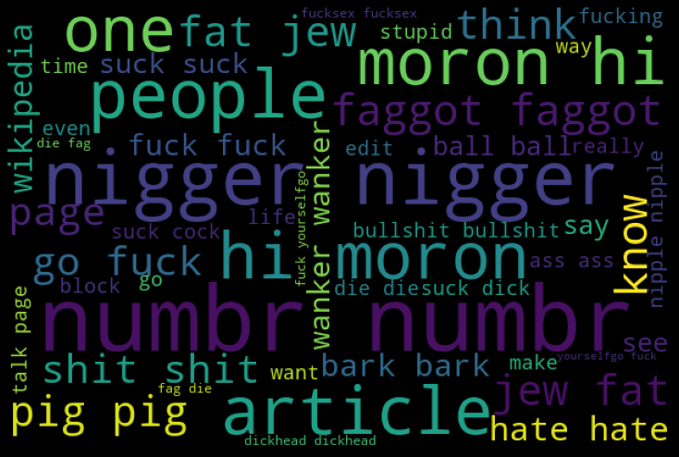

Slide 16
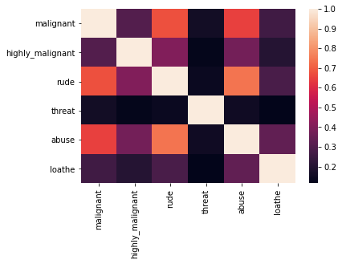
Multivariate Analysis

Slide 17
Model Building
Logistic Regression
Decision Tree Classifier
RandomForest Classifier
AdaBoost Classifier
KNN Classifier

Slide 18
Best Model(Random Forest)
Training accuracy is 0.9988
Test accuracy is 0.9550

Slide 19
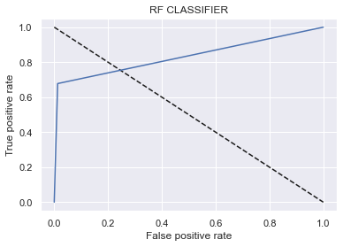
AUC curve

Slide 20
Limitations of this work and Scope for Future Work
This project was amazing to work on , it creates new ideas to think about but there were some limitations in this project like unbalanced dataset, multiple target features.
To overcome these limitations we have to use balanced datset so that during the training of dataset our algorithm will not give biased result.

Slide 21
Conclusion
The conclusion for our study :-
In training dataset we have only 10% of data which is spreading hate on social media.
In this 10% data most of the comments are malignant, rude or abuse.
After using the wordcloud we find that there are so many abusive words present in the negative comments. While in positive comments there is no use of such comments.
Some of the comments are very long while some are very short

